Slide 1


Slide 2


Slide 3
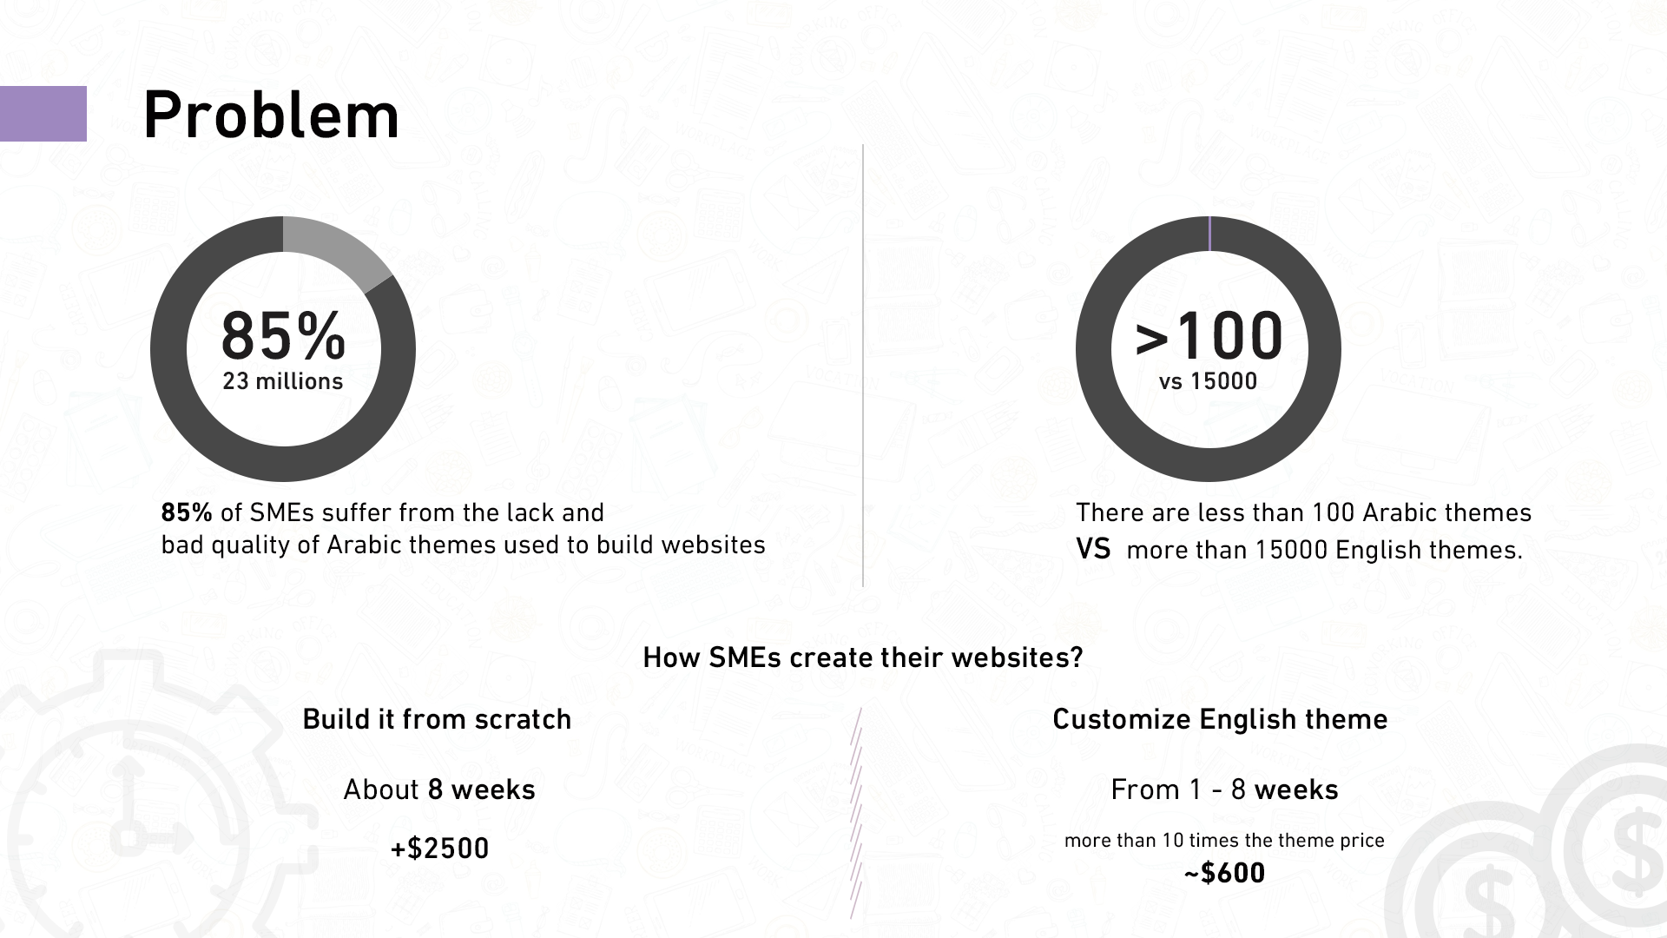

Slide 4
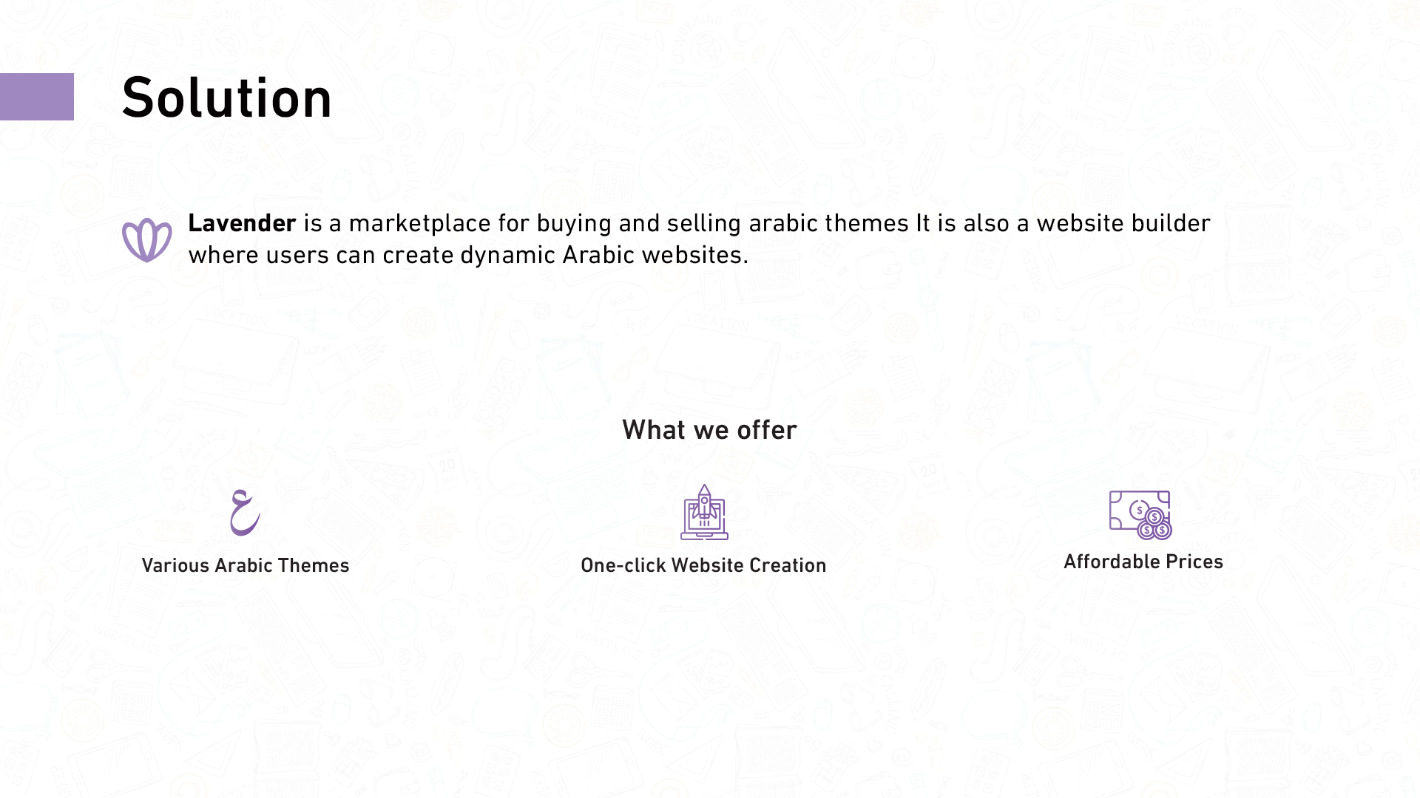

Slide 5
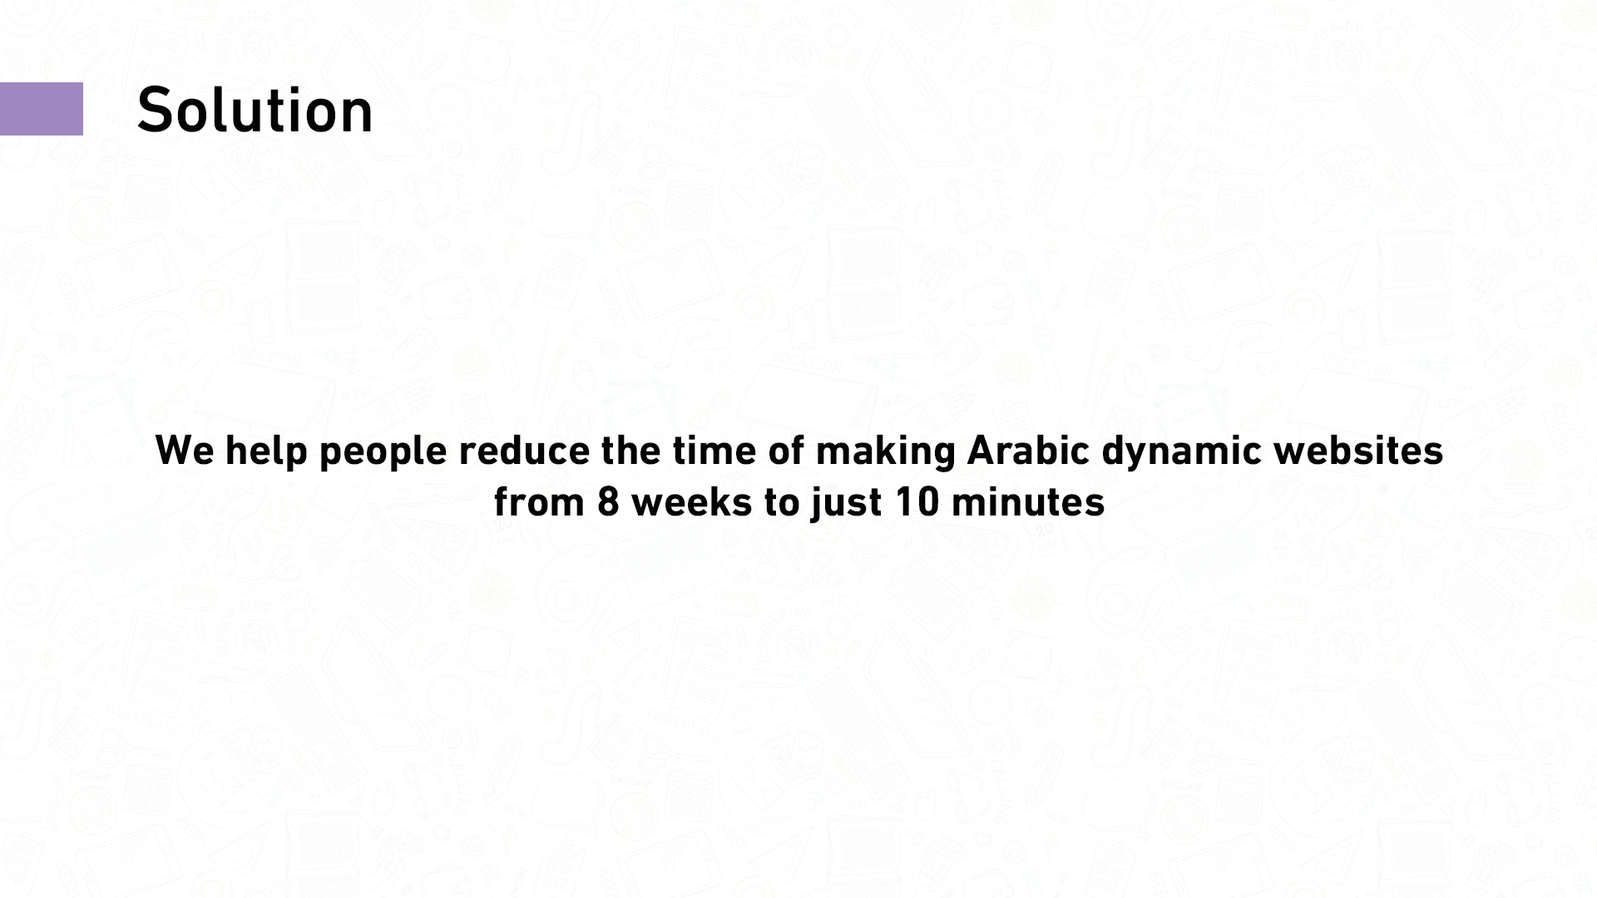

Slide 6
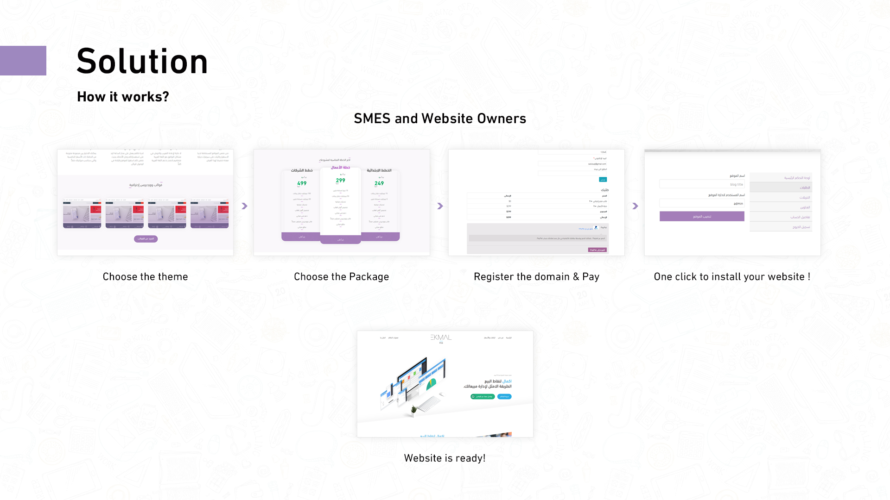

Slide 7
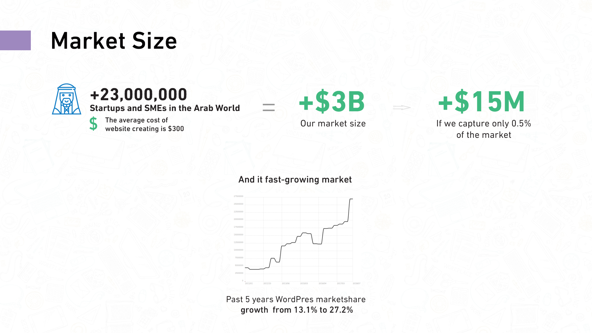
1)Number of SMEs in the MENA-Region
2)51% of small businesses have websites
3)WordPress Usage Statistics

Slide 8
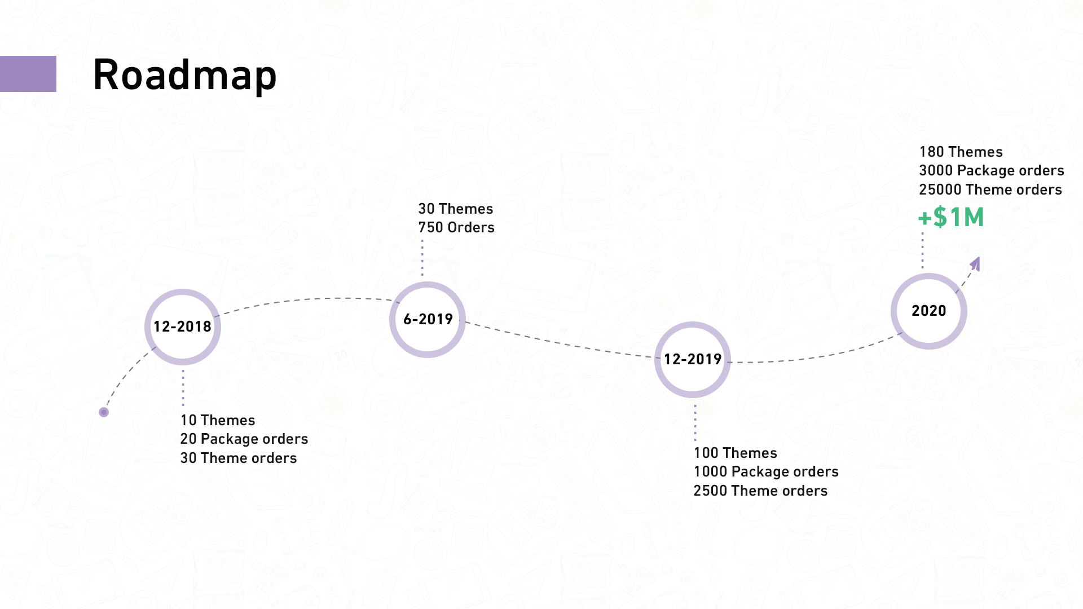

Slide 9
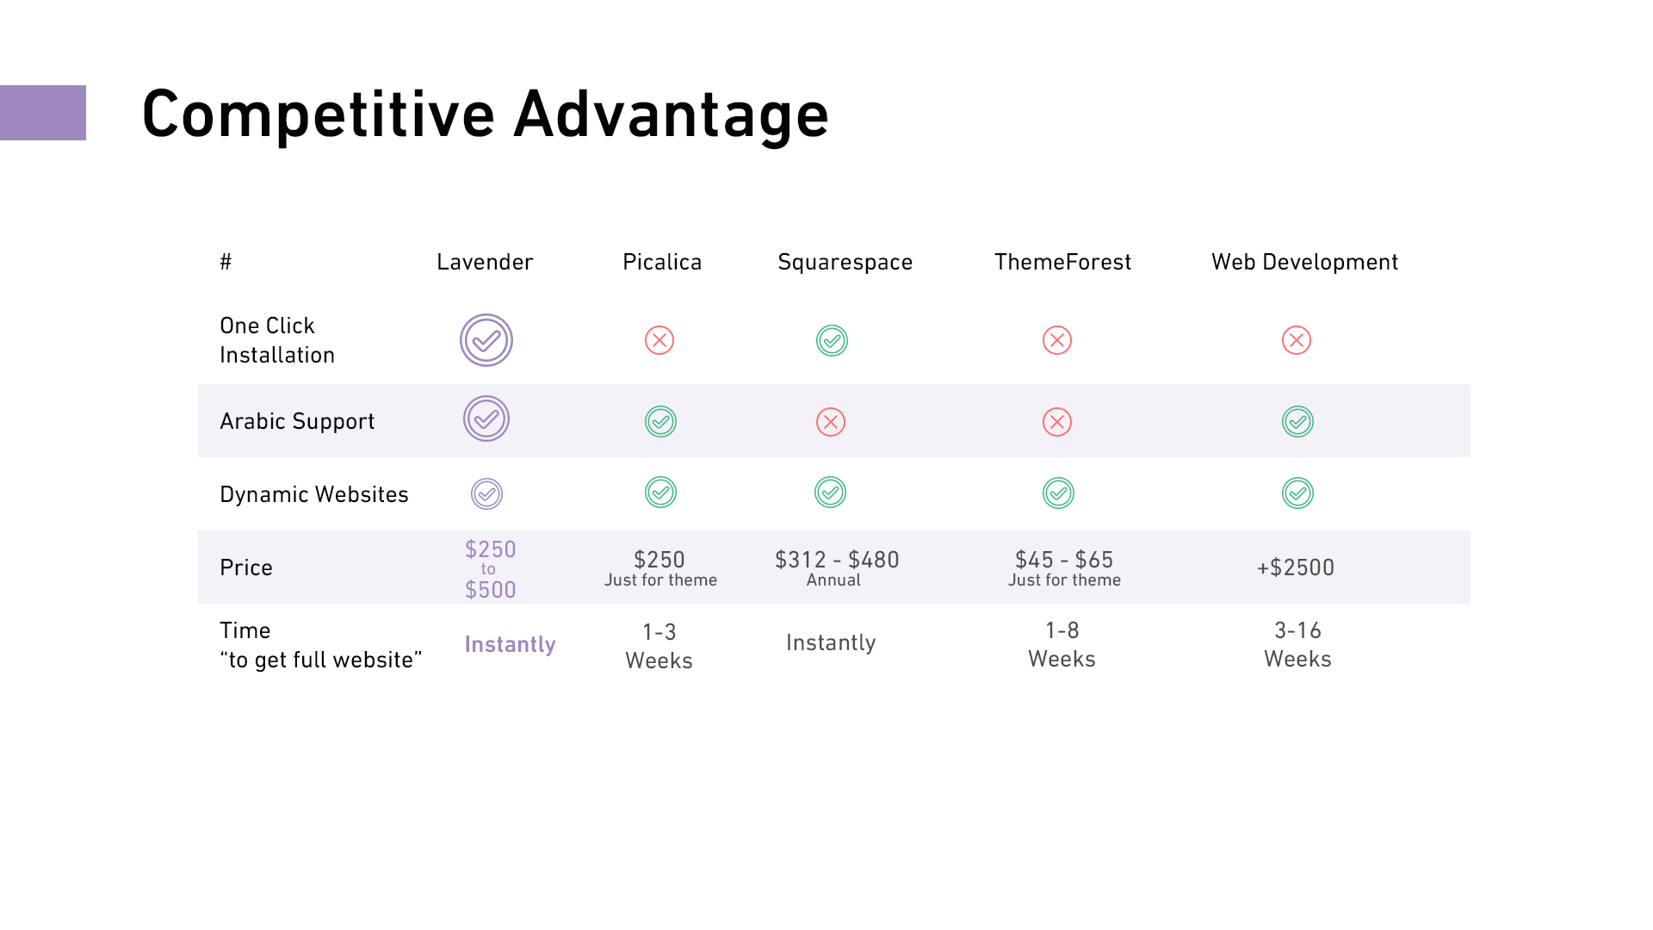

Slide 10


Slide 11
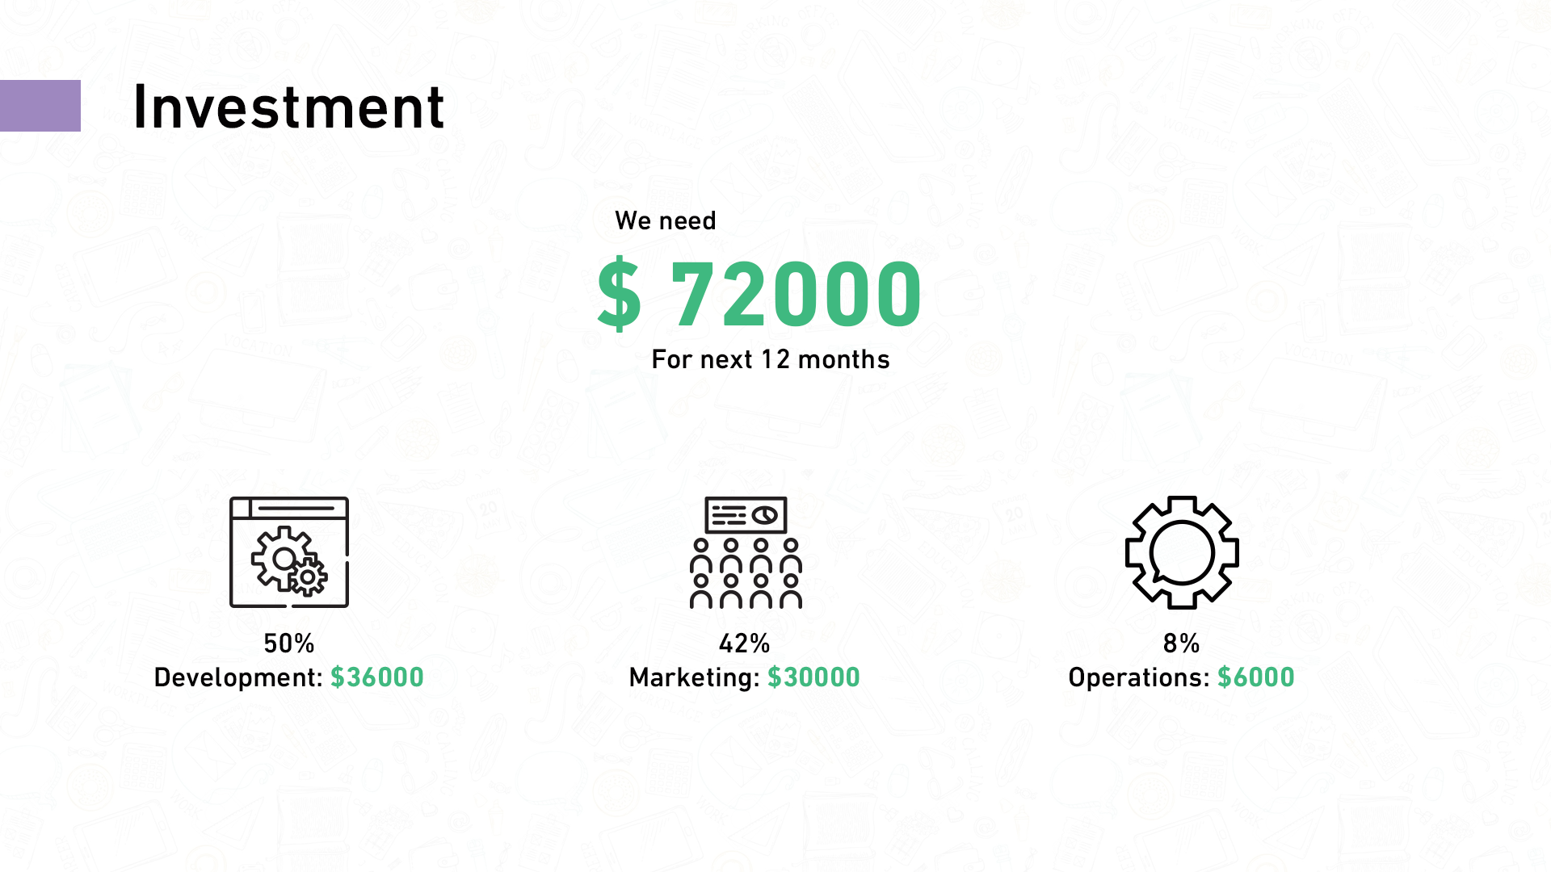

Slide 12


Slide 13


